Slide 1
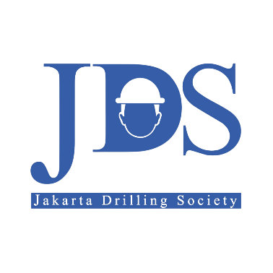
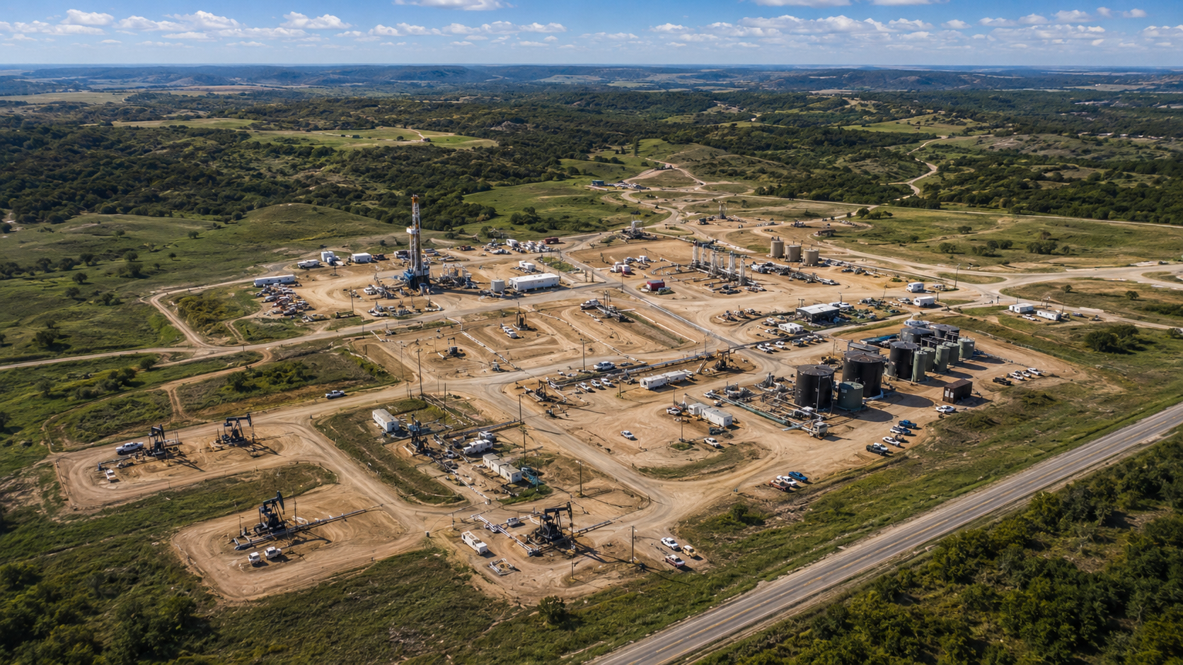

JDS 2026 DRILLING CAMPAIGN
SW (Single Well) DPM (Drilling Project Management) Phase-1: ALPHA-07
CORE ENERGY SOLUTION
GROUP 6 ONLINE

Slide 2
MEET THE TEAM
DE/DRB Members
Name | Role in Project
Abrar Laylramadhan | Project Manager
Asri Permatasari Sirait | Subsurface
Abdi Surya | Subsurface
Adriansyah | Drilling Engineer
Nyoman Prema Ananda | Drilling Engineer
Salman Arkan | Drilling Engineer
Shanaz Ivona Dewi Limaran | HSE Engineer
Hana Malem Karina Panjaitan | Project Contract & Economist
Muhammad Hammam Reza | Project Contract & Economist
Bernard Cavin Ronlei Sihombing | Logistic Coordinator
DE/DRB Members
Name | Role in Project
Yudi Hartono | Decision Executive
Ashadi | DRB Member
Redha Bhawika | DRB Member
Mentors
Name | Role in Project
Abilati Monikha Wulandari | Mentor

Slide 3

OUTLINE
1
EXECUTIVE SUMMARY
2
LOCATION, GEOGRAPHY, & SURFACE RECONNAISSANCE
3
SUBSURFACE GEOLOGICAL PROGNOSIS (G&G DATA)
4
OFFSET WELL ANALYSIS & LESSONS LEARNED
5
CONCEPTUAL WELL CONSTRUCTION DESIGN (PRE-BOD)
6
MINIMUM RIG SPECIFICATIONS & CRITICAL THIRD-PARTY SERVICES
7
PROJECT RISK ASSESSMENT & MITIGATION MATRIX (Corrected Position)
8
PROJECT ECONOMICS & PRELIMINARY AFE
9
PRE-EXECUTION MILESTONES & ROADMAP TO SPUD

Slide 4
EXECUTIVE SUMMARY

Slide 5
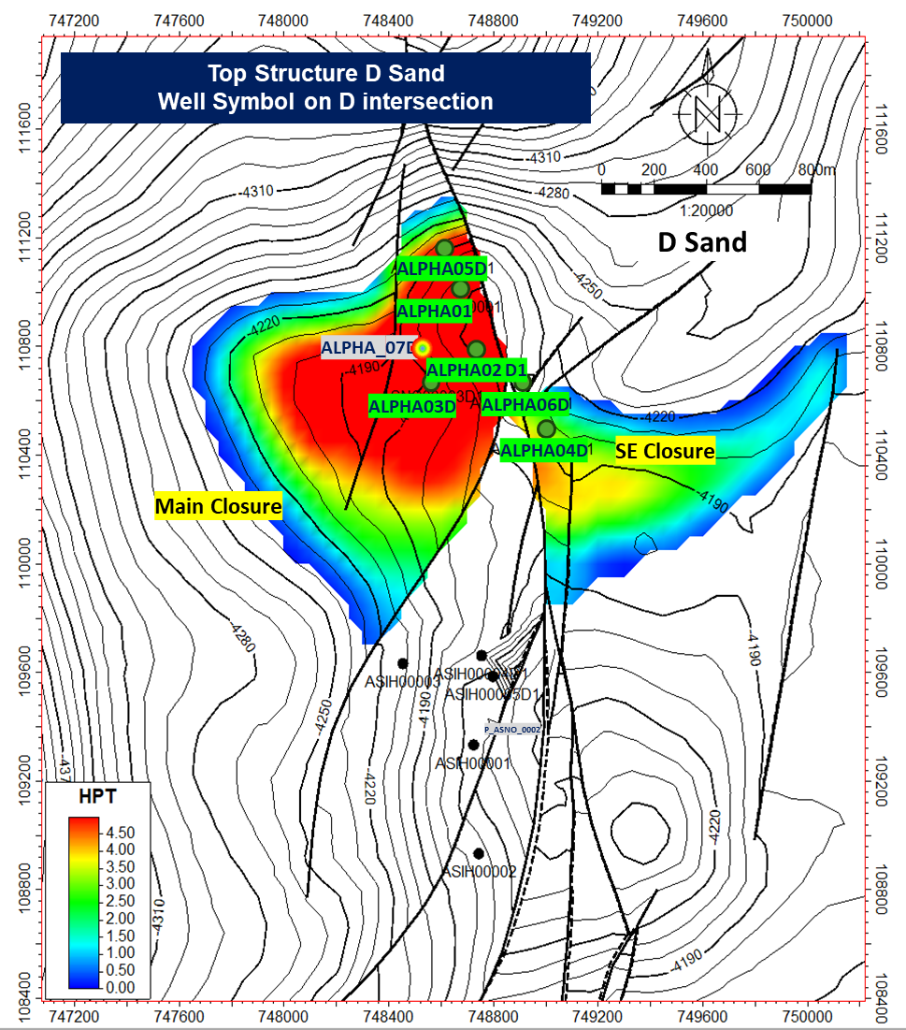
PROJECT MANDATE & JUSTIFICATION
Alpha Field Proposed Development Well Location Map
“Sanction Alpha-07 to unlock stranded reserves at low-risk USD 1.78M investment, delivering incremental recovery of 0.58 MMBO leveraging existing infrastructure.”
Description
Key highlights
Alpha Field is significantly under-developed. With OOIP of 21.66 MMSTB and cumulative production of only 6.48 MMSTB, the recovery factor stands at just 16.62%. The 5-well development program anchored by Alpha-07 provides a phased, capital-efficient pathway to improve recovery using existing surface facilities, promotes the optimization of mature assets, minimizing new infrastructure requirements. Directional J-type design avoids land complications above target reservoirs.
located at Central Sumatra Basin
OOIP 21.66 MMSTB vs 6.48 MMSTB current| Recovery Factor only 16.62%
5-well program delivers ~0.58 MMBO incremental to 2041
Existing CES surface facilities — no major new infrastructure
Wellpad footprint minimized to 2–2.5 ha (J-type directional)
Aligns with SKK Migas production growth targets
21.66 MMSTB
Original Oil in Place (OOIP)
16.62% RF
Current Recovery Factor — significant upside
USD 1.78M
Total D&C Investment (AFE)
05

Slide 6
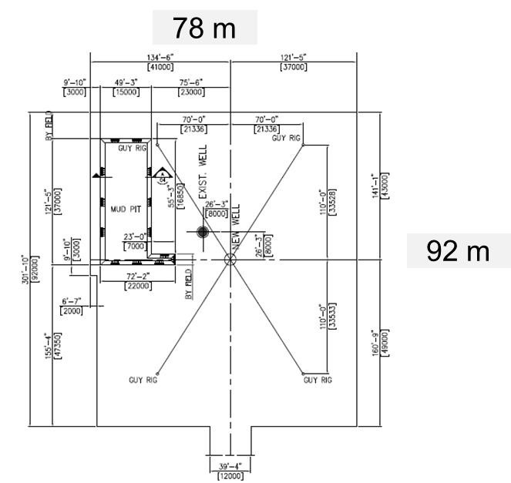
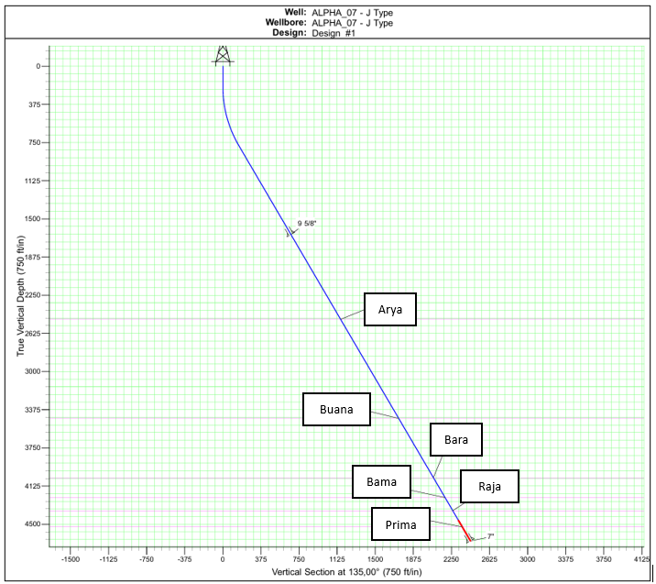
WELL CLASSIFICATION
Typical Design Wellpad Rig Layout 750 HP
Well Trajectory Profile Alpha-07
“Alpha-07 is a Development Well — directional J-type producer with cased-hole completion and ESP artificial lift — the lowest-risk execution path for Alpha Field.”
Description
Key highlights
The four target reservoirs (Bara, Bama, Raja, Prima sands) are fully delineated through 6 prior drilling campaigns (Alpha-01 to Alpha-06), removing subsurface definition risk. Classification as Development Well allows execution team to focus on operational variables: wellbore stability, loss circulation, and cementing quality. ESP is required to overcome field-wide ~99% water cut and sustain economic production rates. the primary objective of the well is hydrocarbon production.
• 6 offset wells (Alpha-01–06) provide direct analog data
• Bara, Bama, Raja, Prima sands: proven hydrocarbon productivity (adequately defined through previous development activities)
• Cased-hole completion enables selective zonal perforation
• ESP: custom-manufactured to well spec; 16–24 week lead time
• Target TD ~4,042–4,676 ft TVD; within 750 HP rig competency
750 HP Rig
Land rig | Directional J-type
~5,312 ft MD
Planned Total Depth
Cased-hole + ESP
Completion design | Artificial lift (Submersible Pump)
06

Slide 7
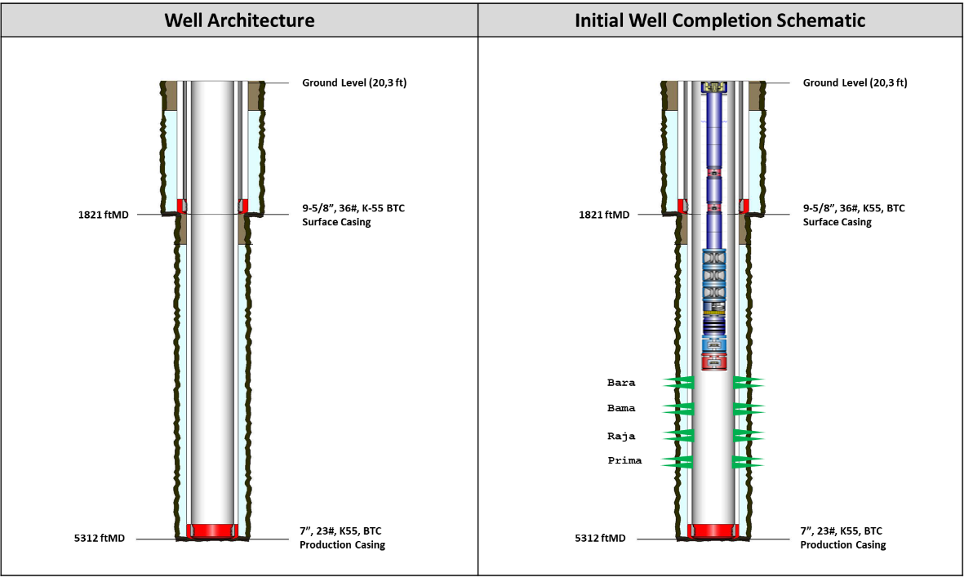
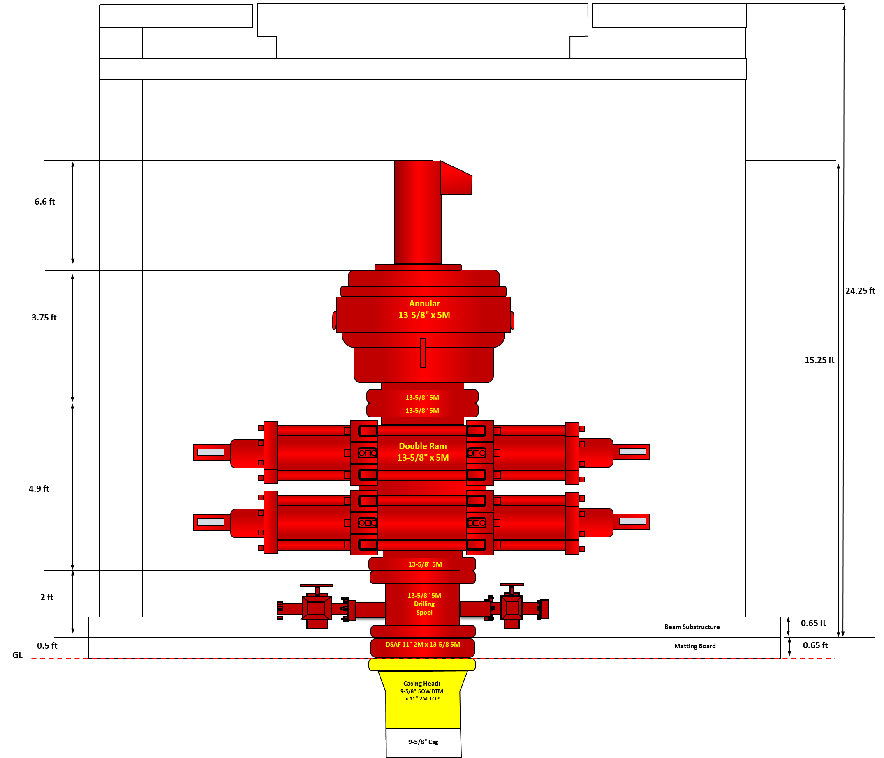
SUCCESS CRITERIA & KPIs
Conceptual casing
Conceptual wellhead
Success is defined by three mutually reinforcing criteria: subsurface data capture, production rate confirmation, and cost discipline — within a zero-LTI HSSE envelope.
~5,000 ft MD
Planned Total Depth | All 4 reservoirs penetrated
132 BOPD
IP P50 | P10–P90: 106–158 BOPD
156 MBO
EUR P50 / well | 5-well = 0.58 MMBO
21.3–29.3 days
Total Well Cycle Time | intra-field: 18%, inter field: 42%, drilling: 34%; completion: 6%
<5–10% NPT
Non-Productive Time Target
Zero LTI
HSSE | SKK Migas + CES compliance
Description:
Gate 1 requires confidence across three dimensions: geological data capture (to de-risk wells 2–5), production validation (DCA-based reserve), and cost control (to keep program investable). Failure on any single dimension impairs the USD ~7.4M 5-well business case.
Key Higlights:
acquiring complete subsurface data by triple combo logging + pressure test + Side Wall Coring required for full formation evaluation
AFE max overrun 10% (USD 177,961 contingency)
DCA-validated by Alpha-01, 02, 05 analogs
Logging program needed for Gate 2 sanction of wells 2–5.
07

Slide 8
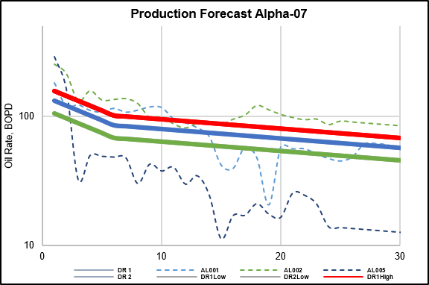
EXECUTIVE SANCTION REQUEST
Production forecast
“Management approval is requested for 3 specific actions:
Sanction Alpha-07 execution
Authorize USD 1.96M AFE + contingency
Formally accept the defined risk envelope to proceed to Gate 2.”
ACTION 1
Sanction Execution
Deploy 750 HP land rig | Alpha-07 directional drilling ops
ACTION 2
Authorize AFE Budget
USD 1,779,610 D&C + USD 177,961 contingency (10%)
ACTION 3
Accept Risk Envelope
0 Extreme | 7 High | 17 Medium | 5 Low risks
USD 422,090
Total Tangible Cost
USD 1,357,520
Total Intangible Cost
Description:
Gate 1 approval unlocks the critical path to Q4 2026 spud. LLI procurement (ESP: 16–24 wk, casing: 12+ wk) must begin immediately upon sanction. Delay cascades directly to spud date and first oil. The risk profile is well-understood — no Extreme risks — all High risks carry defined mitigation protocols. Gate 2 will cover detailed engineering, PPFG calibration, well design freeze, and PTD finalization.
EVIDENCE
LLI: ESP (16–24 wks), 7" Casingg ×140 jts, 9-5/8" Casing ×48 jts, 3½" Tbg ×161 jts
Drawdown authority: DSup (≤5%), PM (5–10%), MgtCom (>10%)
Target spud: 1 November 2026 (Gate 1 approval required Q2 2026)
June 2026
July 2026
Regulatory phase
PTD Submission
AMDAL/UKL-UPL
Land Clearance
Aug 2026 : Contracting
Sep – Oct 2026 : SPUD
VBWO submission
Gate 1 Sanction
AFE Authorization
Engineering phase
BOD finalization
Directional Plan
Rig confirmation
Tender launch
PTD Approval
Contract award
Site preparation
LLI delivery
Gate-2 sign off
Pre-Spud meeting
Rig mobilization
BOP testing
SPUD IN
Gate-1
08

Slide 9
LOCATION, GEOGRAPHY, & SURFACE RECONNAISSANCE

Slide 10
SURFACE & BOTTOM-HOLE COORDINATES
The proposed wells are designed as directional J-type wells with horizontal displacement 2,437 ft MD and a planned total depth of approximately 5,312 ft MD.
Below is the Surface and Subsurface Coordinate Alpha-07 well.
Parameter | X | Y | Remarks
Surface Coordinate | 749,934.38 | 110,089.99 | New Wellpad
Subsurface Coordinate | 749,434.38 | 109,589.99
10

Slide 11
LAND ACQUISITION & CIVIL WORKS STATUS
The Alpha-07 development project requires approximately 2–2.5 ha of land.
Land Rig of 750 HP will be required to drill Alpha-07 well, considering the limitation of land availability.
Please find the Typical Design Wellpad Rig Layout 750 HP
Permit to Drill (PTD) and other regulatory approvals are being processed as part of Project Initiation - Gate 1 Sanction process
The project is progressing from Gate-1 (Project Initiation) towards Gate-2 (Detailed Engineering and Execution Preparation), with major permitting and site preparation activities proceeding according to drilling schedule.
11

Slide 12
TERRAIN & LOGISTICS ACCESSIBILITY
Alpha Field is located in the southern part of WK Core Energy Solution in an onshore environment characterized by a combination of plantation areas, forested land, and operationally constrained zones
The terrain is generally flat, which facilitates drilling and infrastructure development.
Rig mobilization is estimated at approximately 6 days for intra field moves and up to 14 days for inter field mobilization.
Mobilization preparation will be in accordance with applicable API and ASME requirements.
12

Slide 13
SUBSURFACE GEOLOGICAL PROGNOSIS (G&G DATA)

Slide 14
GEOLOGICAL TARGET & HYDROCARBON POTENTIAL
Formation | Sand Marker | Reservoir Target | Estimated Fluid Content
Surface | - | No | Water
Arya | T_A1 | No | Water
Arya | T_A2 | No | Water
Buana | T_B1 | No | Water
Buana | T_B2 | No | Possible Water
Buana | T_B3 | No | Possible Water
Buana | T_B4 | No | Possible Water
Buana | T_B5 | No | Water
Bara | T_C1 | Yes | Oil
Bara | T_C2 | No | Oil
Bara | T_C3 | No | Water
Bara | T_C4 | No | Water
Bara | T_C5 | No | Oil
Bara | T_C6 | No | Water
Bama | T_D1 | No | Possible Water
Bama | T_D2 | Yes | Oil & Gas
Bama | T_D3 | No | Possible Water
Bama | T_D4 | No | Water
Bama | T_D5 | No | Oil
Bama | T_D6 | No | Possible Water
Raja | T_E1 | Yes | Oil
Raja | T_E2 | No | Possible Water
Raja | T_E3 | Yes | Oil
Raja | T_E4 | No | Water
Raja | T_E5 | Yes | Oil
Prima | T_F1 | Yes | Oil
Prima | T_F2 | No | Water
Prima | T_F3 | No | Water
Basement | T_BSM | No | Water
Formation | Lithology | Interval Depth (ftTVD) | Subsurface Drilling Hazard Remarks
Surface | Soft & Clay | 0-2487 | No Issue
Arya | Shale | 2487-3460 | Sloughing shale, Gumbo, Tight hole
Buana | Sandstone | 3460-4042 | Sloughing shale, Gumbo, Tight hole
Bara | Sandstone | 4042-4238 | Loss Circulation, Tool Stop
Bama | Sandstone | 4238-4367 | Loss Circulation
Raja | Sandstone | 4367-4527 | Loss Circulation
Prima | Sandstone | 4527-4676 | Loss Circulation
14

Slide 15
OFFSET WELL ANALYSIS & LESSONS LEARNED

Slide 16
OFFSET WELL OVERVIEW
PARAMETER | ALPHA 00001 (O-O-44) | ALPHA 00002 (O-O-64) | ALPHA 00003 (O-O-74) | ALPHA 00004 (O-O-74A) | ALPHA 00005 (O-O-44A) | ALPHA 00006 (O-O-66)
Spud Date | 23-May-2000 | 30-Oct-2000 | 01-Jun-2008 | 13-Jun-2008 | 29-Jun-2008 | 17-Oct-2012
Well Type | SOW | DOW (S-Type) | DOW (J-Type) | DOW (J-Type) | DOW | DOW
Casing Design | 24"-9⅝"-7" | 24"-9⅝"-7" | 9⅝"-7" | 13⅜"-9⅝"-7" | 9⅝"-7" | 24"-9⅝"-7"
TD (ft MD) | 5,143 | 5,036 | 5,390 | 5,448 | 5,186 | 5,602
Surf. CSG Depth (ft) | 1,469 | 1,225 | 1,233 | 1,237* | 1,245 | 1,300
MW Range (ppg) | 8.8–9.8 | 8.8–9.8 | 8.7–10.1 | 8.8–9.4 | 8.8–10.7 | 8.5–9.6
FIT (ppg) | 13.46 | 13.46 | 14.4 | 14.4 | 14.4 | 13.44
Surf. ROP (fph) | 48 | 47 | 47 | 49 | 50 | 52
Prod. ROP (fph) | 39 | 41 | 44 | 45 | 43 | 47
CMT Return (7" Prod.) | None | 10 bbls | 34 bbls | 3 bbls | 15 bbls | 140 bbls
16
* Alpha 00004 has additional Intermediate 9⅝" section at 3,858 ft

Slide 17
WELLBORE PROBLEM MATRIX
WELLBORE ISSUE | SECTION | A-001 | A-002 | A-003 | A-004 | A-005 | A-006
Tight Hole / Tagging | Production | MINOR | MINOR | MAJOR | MAJOR | MAJOR | MINOR
High Torque & Drag | Production | MAJOR | MINOR | MAJOR | MINOR | MINOR | MINOR
Sloughing Shale | Production | MINOR | NORMAL | MINOR | NORMAL | MAJOR | NORMAL
Gumbo / Reactive Clay | Surface | NORMAL | MAJOR | NORMAL | NORMAL | NORMAL | NORMAL
Pack-Off / Swabbing | Production | MAJOR | MINOR | NORMAL | NORMAL | NORMAL | NORMAL
Casing Running Stop | Production | NORMAL | NORMAL | MAJOR | MAJOR | MAJOR | NORMAL
Logging Tool Stop | Production | NORMAL | MAJOR | MAJOR | MINOR | MAJOR | NORMAL
Stuck Wireline | Production | NORMAL | NORMAL | MAJOR | NORMAL | NORMAL | NORMAL
No CMT Return (Surface) | Surface | NORMAL | MAJOR | MAJOR | MINOR | NORMAL | NORMAL
Equipment Failure | Any | NORMAL | MINOR | MINOR | MAJOR | MINOR | MAJOR
Hard Formation | Production | NORMAL | NORMAL | NORMAL | NORMAL | MAJOR | MINOR
MAJOR
MINOR
NORMAL
N/A
17

Slide 18
WELLBORE STABILITY ANALYSIS
TIGHT HOLE / TAGGING
5/6 Wells
SLOUGHING SHALE
3/6 Wells
Depth range: 1,342–5,316 ft MD
Depth range: 1,743–5,186 ft MD
Alpha 3: Tagged at 5316', 5330', 5354' – multiple reaming passes
Alpha 4: Tagged at 2623', 3310', 3325', 3372', 3786' – casing required swage
Alpha 5: Tagged at 3854', 4197', 4467', 5127' – required multiple wiper trips
Alpha 6: Drag 40 klbs at 4873'–4868' during wiper trip
Alpha 5: Continuous sloughing shale cutting (1-2" × 1/3" width) over shakers
Alpha 5: Required MW increase from 9.1 to 10.0 ppg to stabilize
Alpha 2: Gumbo circulation – wiper trip required at 3286'
Alpha 3: Increased MW to 10.1 ppg – hi-vis sweeps performed
HIGH TORQUE & DRAG
4/6 Wells
GUMBO / REACTIVE CLAY
2/6 Wells
Depth range: 2,000–5,350 ft MD
Depth range: 1,400–3,286 ft MD
Alpha 1: Hi-torque at 4240'–4518' – decided to POOH & change bit
Alpha 3: Overpull 50 klbs – casing point decided based on instability
Alpha 4: High drag during POOH 50 klbs at 3659' & 45 klbs at 3638'
Alpha 6: Drag 40 klbs during final trip – reciprocated string OK
Alpha 2: Circulated out gumbo after wiper trip from 1404'–3286'
Alpha 2: Required additional KCl spotting to stabilize reactive clay
Alpha 4: Cellar full of clay – required jetting with wash gun
Common occurrence in bara shallow-intermediate section
18

Slide 19
CEMENTING ANALYSIS
No CMT Return (Surface):
Alpha 002 & 003 – full circulation but ZERO cement return on surface casing. Suspected lost circulation at shallow depth.
Excess CMT Return (Intermediate/Production):
Alpha 004: 100 bbls at 13-3/8" surface & Alpha 006: 140 bbls at 7" production – indicates good hole cleaning & excess volume required.
Best Practice – Fluid Caliper:
Alpha 006 performed fluid caliper using Hi-Vis sweeps, determining 300% excess for lead cement. This improved cement job quality significantly.
Bump Plug Pressure:
All wells confirmed float valve hold after bumping plug at 890 – 1800 PSI. Consistent float equipment reliability across all 6 wells.
19

Slide 20
DRILLING PERFORMANCE COMPARATION
KEY ROP INSIGHTS
Surface Section Average:
~49 fph
Consistent drilling performance.
Production Section Average:
~43 fph
Lower ROP due to drilling conditions.
Best Performer:
Alpha 006 (47 fph)
Highest production ROP.
Slowest Performer:
Alpha 001 (39 fph)
Lowest production ROP.
20

Slide 21
MUD PROGRAM & CASING CHALLENGES
WELL | CASING CHALLENGE | SOLUTION | STATUS
Alpha 003 | Casing stop @ 5332' High torque & overpull 50 klbs | Decided casing point @ TD; used casing swage | SUCCESS
Alpha 004 | CSG stop @ 3784' (Int.) Tagged at multiple depths during RIH | Installed casing swage, washed down to 3857' | SUCCESS
Alpha 005 | CSG stop @ 5157' Casing could not go down | Set shoe @ 5146' (11 ft short of TD) | PARTIAL
Alpha 002 | Tight hole during wiper trip 3996'–4038' washed down | Washed & conditioned before casing run | SUCCESS
21
CASING RUNNING CHALLENGES & SOLUTIONS

Slide 22
LESSON LEARNED
01
WELLBORE STABILITY IS THE #1 RISK
02
CASING RUNNING REQUIRES PRE-CONDITIONING
Tight hole was encountered in 5/6 wells, predominantly in the production section (8.5" hole)
Sloughing shale requires proactive MW management – do not wait for signs to increase
Multiple wiper trips before logging & casing are MANDATORY, not optional
Three wells (A-003, A-004, A-005) required casing swage – this must be part of standard equipment
Always perform conditioning trip to TD before running casing; ensure hi-vis sweeps are conducted
In deviated wells, increase circulation time and monitor T&D carefully before & during casing run
03
LOGGING OPERATIONS NEED ENHANCED PLANNING
04
CEMENTING: FLUID CALIPER & EXCESS VOLUME
Tool stop occurred in 3/6 wells – pre-logging wiper trips significantly reduce this risk
Alpha-003: Stuck MR Scanner required full fishing operation (20+ hours NPT) – avoid by pre-conditioning
Have contingency plan ready: shorter logging assemblies, spare tools, fishing tools on standby
Surface casing: No CMT return in 2/6 wells – design with lost circulation zone assumption
Use fluid caliper (Hi-Vis monitoring) to determine actual hole volume before cementing
Alpha-006 best practice: 300% excess lead, 40% excess tail CMT based on fluid caliper result
22

Slide 23
CONCEPTUAL WELL CONSTRUCTION DESIGN (PRE-BOD)

Slide 24
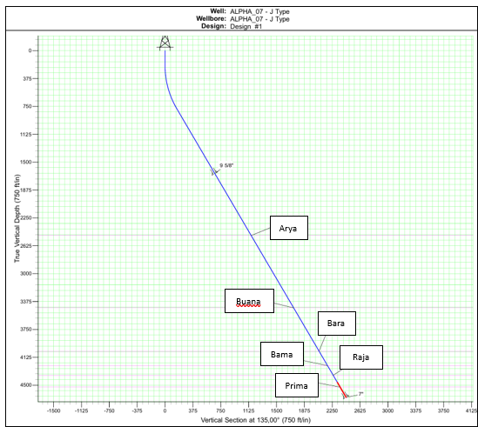
TRAJECTORY DESIGN & RATIONALE
J-Type selected due to large surface-to-target offset
Simpler profile than S-Type, reducing torque, drag, and operational risk
Items | Alpha-07 (J-Type)
BUR, deg | 5
KOP, ftMD | 200
EOB, ftMD | 808,2
Inclination, deg | 30.41
Azimuth, deg | 135
Horizontal Displacement | 2437
Surface CP, ftMD/ftTVD | 1821/1654
Production CP, ftMD/ftTVD | 5312/4664
24

Slide 25
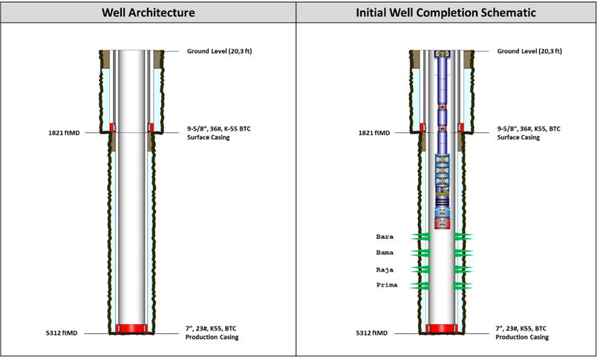
CASING & COMPLETION PROGRAM
Surface Casing: 9-5/8 in, 36 ppf, K55 BTC @ 1,821 ft MD - shallow formations and provide structural support
Production Casing: 7 in, 23 ppf, K55 BTC @ 5,312 ft MD
Cased-hole completion with selective perforations
ESP installed to support expected fluid rates and high water cut
25

Slide 26
DRILLING FLUIDS STRATEGY
Water-Based Mud (WBM) KCl-Polymer system throughout well
Surface section MW: 8.7–9.0 ppg
Production section MW: 9.0–9.8 ppg
Minimum KCl concentration: 5%
Designed to control shale swelling, maintain stability, and improve hole cleaning in directional intervals
26

Slide 27
CEMENTING STRATEGY & KEY OBJECTIVES
Parameter | Surface Section (12-1/4" OH – 9-5/8" Casing) | Production Section (8-1/2" OH – 7" Casing)
Depth | 1821 ftMD | 5312 ftMD
Mud Type | WBM KCl-Polymer | WBM KCl-Polymer
Mud Weight (MW) | 8.7–9.0 ppg | 9.0–9.8 ppg
Rheology (PV/YP) | PV: ALAP, YP: 16–22 | PV: ALAP, YP: 26–30
KCl Concentration | 5% | 5%
Cement Type | Class G cement | Class G cement
Spacer | 11.0 ppg scavenger | 11.0 ppg scavenger
Slurry Design | Dual slurry: Lead 12.5 ppg, Tail 15.8 ppg | Dual slurry: Lead 12.5 ppg, Tail 15.8 ppg
Tail Cement Length | Min 200 ft above casing shoe | Min 500 ft above C sand
Special Additives | – | Light Weight cement + fiber if loss circulation occurs
Bump Plug | 500 psi above final circulating pressure | 500 psi above final circulating pressure
Main Objective | Stabilize shallow hole, isolate surface formations, provide mechanical support for deeper casing | Isolate reservoir (bara sand), prevent gas migration, ensure long-term zonal isolation during production
27

Slide 28
MINIMUM RIG SPECIFICATIONS & CRITICAL THIRD-PARTY SERVICES

Slide 29
MINIMUM RIG SPECIFICATIONS
Category | Parameter | Minimum Specification | Design Basis
RIG SYSTEM | Rig Type | Land Drilling Rig – Conventional | Onshore operation
 | Rated Hook Load | 300,000 lbs (300K) | 7" casing 23 ppf × 5,312 ft MD + drill string + safety margin
 | Substructure Clear Height | Min. 25 ft | BOP space out total height 24.25 ft (Fig 6.1 – Casing Head configuration)
 | Drawworks Power | ≥ 500 HP | TD 5,312 ft MD; J-type directional profile with torque & drag load
ROTARY / TOP DRIVE | Top Drive | Required (electric or hydraulic) | J-type trajectory; 30.41° max inclination — rotary kelly not suitable
 | Rotary Table Opening | Min. 17½" | Accommodate 12¼" bit & 9⅝" casing with tool joint through rotary
HYDRAULICS | Mud Pump | 2 units × ≥ 500 GPM each | ECD management & hole cleaning in 12¼" directional interval (BUR 5°/100ft)
 | Stand Pipe Pressure Rating | ≥ 3,000 psi | WBM KCl-Polymer; MW 8.7–9.8 ppg; directional section
 | Active Mud Pit Volume | Min. 3× open hole volume | Full-well WBM KCl-Polymer; fluid management & contingency
WELL CONTROL | BOP Stack Configuration | Annular 13-5/8" × 5M + Double Ram 13-5/8" × 5M | Per BOP space out Fig 6.1 & 6.2 — Annular + Blind Ram + Pipe Ram
 | BOP Pressure Rating | 5,000 psi (5M) – API 16A | BOP components rated 5M per space out drawing; production section up to 5,312 ft MD
 | Choke Manifold | Annular + Blind Ram + Pipe Ram configuration | Per Fig 6.3 – Choke Manifold with check valve, NO/NC valve arrangement
POWER & UTILITIES | Power Generation | Min. 750 kVA total | All rig services + MWD/LWD tools + wireline units + ESP installation
 | Data / Communications | WITSML real-time data link | MWD/LWD downhole telemetry & remote monitoring capability
29

Slide 30
CRITICAL THIRD-PARTY SERVICES
01
Directional Drilling & MWD/LWD
02
Mud Engineering (Drilling Fluids)
Real-time downhole trajectory monitoring & control throughout build and tangent sections
WBM KCl-Polymer design, on-site maintenance, MW & rheology control per hole section
▸ J-type; KOP 200 ft MD; BUR 5°/100ft; 30.41° inclination; horizontal offset 2,437 ft
▸ MW 8.7–9.0 ppg (surface) / 9.0–9.8 ppg (prod); KCl ≥5%; YP 16–22 / 26–30; reactive clay mitigation
03
Mud Logging
04
Cementing Services
Continuous gas monitoring, lithology identification & drilling parameter recording
Dual slurry design, mixing, pumping & post-job evaluation — both casing sections
▸ Full well coverage; critical at bara sand entry for hydrocarbon detection
▸ Class G; Lead 12.5 ppg / Tail 15.8 ppg; tail min 500 ft above Bara sand / bara reservoir
05
Wireline Logging
06
Perforating Services
Open-hole petrophysical evaluation for reservoir characterization & well correlation
Selective cased-hole perforating across target sand intervals per completion design
▸ Post-drilling formation evaluation; reservoir presence, HC indication & well condition
▸ Cased-hole completion; selective perforations — C/D/E/F Sand bara intervals
07
ESP Contractor
Electric Submersible Pump supply, installation & commissioning (custom-manufactured)
▸ LLI Cat-1: lead time 16–24 weeks; well-specific design (reservoir depth, flow rate, GOR)
30

Slide 31
PROJECT RISK ASSESSMENT & MITIGATION MATRIX (Corrected Position)

Slide 32
PROJECT RISK ASSESSMENT & MITIGATION MATRIX SUMMARY
KEY FINDINGS :
Primary Risk Driver: Loss Circulation and Differential Sticking
Dominant subsurface hazards originate from shale/tight-hole intervals
Secondary risks include LLI/ESP supply chain, well control, permitting, and HSE
Recommended contingency provision: USD 177,961
Total AFE including contingency: USD 1.96 MM
No | Risk Description | Potential Consequence | L | C | Rating | Mitigation / Contingency Plan | Residual Risk | Cost Impact (USD)
Subsurface & Well Construction Risks (Estimated Contingency Allocation: USD 135,000)
1 | Loss Circulation | Partial/total losses, cement failure, well-control risk | 4 | 4 | 16 | ECD control, HiVis sweep, preventive LCM/fiber, LW cement + top-job SOP | 8 | 30,000
2 | Differential Sticking | Stuck pipe, fishing job, NPT | 3 | 4 | 12 | Maintain MW within drilling window, monitor shale volume and cavings | 6 | 35,000
3 | Surface Leaking | Surface losses, poor cement job, weak shoe integrity | 3 | 4 | 12 | Piled conductor, 300 GPM/90 RPM early hole, LCM/cement plug if losses persist | 6 | 15,000
4 | Item Procurement Delay | Delayed spud, well construction delay, cost escalation | 3 | 4 | 12 | Gate-1 procurement, delivery tracking, backup suppliers | 6 | 32,000
5 | ESP & Completion Equipment Supply Chain Disruption | Deferred production, rig standby, completion delay | 3 | 4 | 12 | Early ESP award, 50/80/100% fabrication checks, final spec alignment | 6 | 23,000
Operational, HSE & Regulatory Risks (Estimated Contingency Allocation: USD 42,961)
6 | Well Control Incident / Blowout | Loss of well, casualties, pollution, sanction | 2 | 5 | 10 | Certified BOP/choke, IWCF/IADC crew, weekly BOP drill, dual barriers | 4 | 20,000
7 | Personal Injury / LTI | Fatality/serious injury, shutdown, reputation damage | 2 | 4 | 8 | JSA/STARRT, daily briefing, zero-LTI target, near-miss investigation | 4 | 5,000
8 | PTD Delay / Non-Compliance | Late spud, regulatory sanction, schedule overrun | 3 | 3 | 9 | Parallel PTD process, SKK Migas coordination, complete design/env/land documents | 4 | 7,000
9 | Drilling Fluid & Mud Waste Spillage | Soil/groundwater pollution, violation, complaint | 3 | 3 | 9 | Geomembrane-lined pits, CMTF disposal, daily berm/liner inspection | 4 | 6,000
10 | NPT Exceeding Target | AFE overrun, schedule delay to next wells | 3 | 3 | 9 | NPT <5–10%, daily performance review, apply offset-well lessons | 4 | 4,961
32

Slide 33
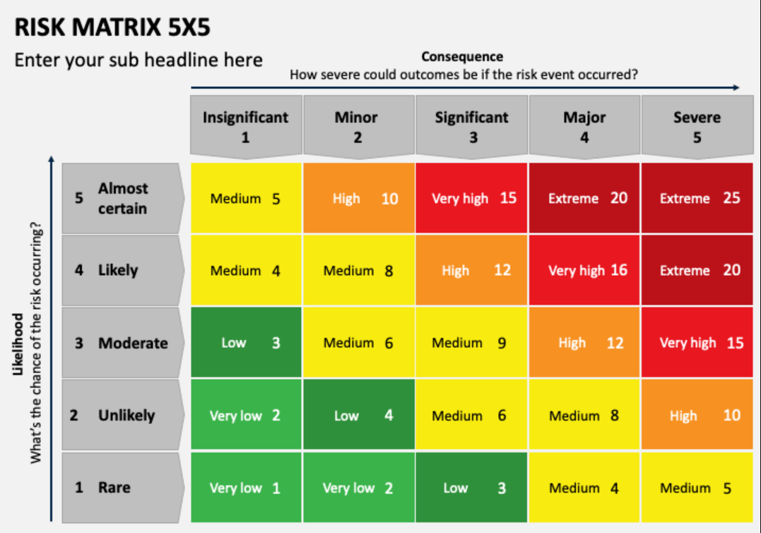
RISK HEAT MAP & CONTINGENCY BUDGET ALLOCATION
RISK HEAT MAP CLASSIFICATION
RISK HEAT MAP CLASSIFICATION
Risk Category | Estimated Cost (USD)
Subsurface Technical Risks | 80,000
Operational & Equipment Risks | 59,961
HSE, Regulatory & Community Risks | 23,000
Recommended Management Reserve | 15,000
Total Recommended Contingency Budget | 177,961
The overall project risk is considered manageable with the proposed mitigation measures and contingency provision of USD 177,961. The dominant exposure remains loss circulation, wellbore instability, and execution readiness including critical equipment supply.
TOP PROJECT RISKS :
1. Loss Circulation (16) → High
2. Differential Sticking (12) → High
3. Surface Leaking (12) → High
4. Item Procurement Delay (12) → High
5. ESP & Completion Equipment Supply Chain Disruption (12) → High
6. Well Control Incident / Blowout (10) → High
Recommendation
✅ Proceed with drilling execution
RISK REDUCTION STRATEGY :
Mud System Optimization
Wellbore Stability Management
Loss Circulation Mitigation
Procurement Tracking for Critical Items
Well Control Readiness
Successful well delivery will depend on disciplined wellbore stability management, proactive loss circulation control, timely procurement of critical equipment, and strong well control and HSE readiness throughout the drilling campaign.
33

Slide 34
PROJECT ECONOMICS & PRELIMINARY AFE

Slide 35

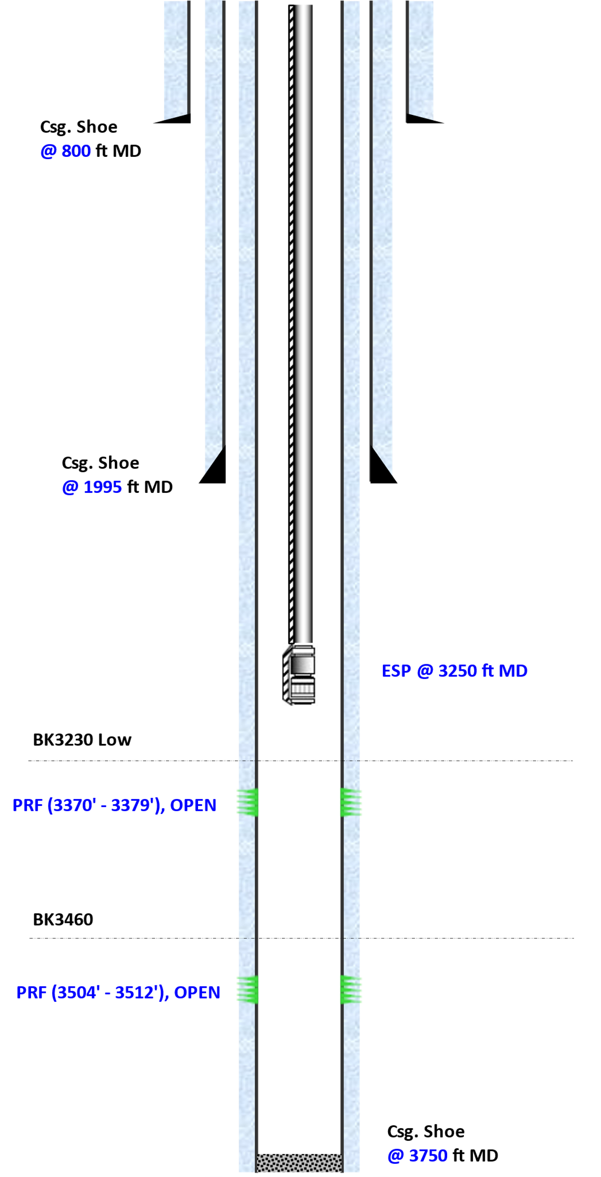

PRODUCTION FORECAST ALPHA-07
Initial Completion
Production Forecast
Forecast Validation
Summary
Alpha-07 akan diproduksikan secara commingle dari formasi BARA, BAMA, RAJA, dan PRINA
Expected 1st IP untuk base case ~132 BOPD dengan EUR ~156 MBO
Metode Forecast menerapkan probabilistik dari data produksi sumur sekitar dengan double decline rate 105% dan 20%.
BARA
BAMA
Alpha-07
 | P10 | P50 | P90
IP, BOPD | 106 | 132 | 158
FLUID, BFPD | 2000 | 2000 | 2000
WC, % | 95% | 93% | 92%
1st Decline | 105% | 105% | 105%
2nd Decline | 20% | 20% | 20%
Add Reserve, MBO | 122 | 156 | 190
RAJA
Watercut Forecast
PRIMA
Economic Variables Input (Assumption before tax) | MUSD By Well
Tangible Drilling | 422,090
Intangible Drilling | 1,357,520
Intangible Road and Location | 601,388
Production Facilities | 1,011,278
35

Slide 36
ECONOMIC ASSESMENT ALPHA-07
Initial Completion
Economic Variables
Summary
Alpha07 berlokasi di XX Area with Main target sand bara, Bangko, Menggala, dan Pematang
Expected 1st IP untuk base case ~132 BOPD dengan EUR ~156 MBO
Metode Forecast menerapkan probabilistik dari data produksi sumur sekitar dengan double decline rate 105% dan 20%.
Economic Variables Input (Assumption before tax) | MUSD By Well
Tangible Drilling | 422,090
Intangible Drilling | 1,357,520
Intangible Road and Location | 601,388
Production Facilities | 1,011,278
BARA
Economic Calculation
BAMA
Alpha-07
 | P10 | P50 | P90
IP, BOPD | 106 | 132 | 158
FLUID, BFPD | 2000 | 2000 | 2000
WC, % | 95% | 93% | 92%
1st Decline | 105% | 105% | 105%
2nd Decline | 20% | 20% | 20%
Add Reserve, MBO | 122 | 156 | 190
RAJA
Well | HPT | IP (BOPD) | EUR (MBO) | ECONOMIC ASSESMENT
 |  |  |  | Capex (MUSD) | NPV (MUSD) | ROR | POT
Low | 15.6 | 106 | 122 | 3.765 | 1.094 | 29% | 3,9
Base |  | 132 | 156 |  | 2.118 | 51% | 2,8
High |  | 158 | 190 |  | 3.140 | 82% | 2,1
PRIMA
36

Slide 37
PRE-EXECUTION MILESTONES & ROADMAP TO SPUD

Slide 38
TERRAIN & LOGISTICS ACCESSIBILITY
June 2026
July 2026
August 2026
September 2026
October 2026
Phase 1 – Gate 1
Phase 2 – Engineering
Phase 4 – Contracting
Phase 5 – Pre-Spud
VBWO submission
BOD finalization
Rig confirmation
Gate 2 sign-off
Trajectory, casing, mud
Internal Review
Directional plan
Availability commitment
All BOD & permits closed
Gate 1 sanction
Anti-collision check
Tender launch
Pre-spud meeting
Mgmt approval
ESP spec & order
Logging, cement, wireline
All contractors, HSE, PMT
Manufacturing auth.
AFE Authorization
LLI Procurement
PTD approval
Rig mobilization
Cost code issuance
Casing, tubing, wellhead
Receipt from SKK Migas
Move & rig-up completion
Phase 3 – Regulatory
Contract award
BOP test & cert.
PTD submission
All key contractors
Function & pressure test
SKK Migas application
Site preparation
Env. permit confirm
Spud-In Target Date:
1 November 2026
AMDAL / UKL-UPL
Wellpad, access road
SPUD AUTHORIZATION
Land clearance
LLI delivery confirm
Alpha-07 — Q4 2026
LI / LER completion
Casing, tubing to yard
01

Slide 39
JDS 2026 DRILLING CAMPAIGN
SW (Single Well) DPM (Drilling Project Management) Phase-1: ALPHA-07
CORE ENERGY SOLUTION
GROUP 6 ONLINE

